Slide 1
Simulation

Slide 2
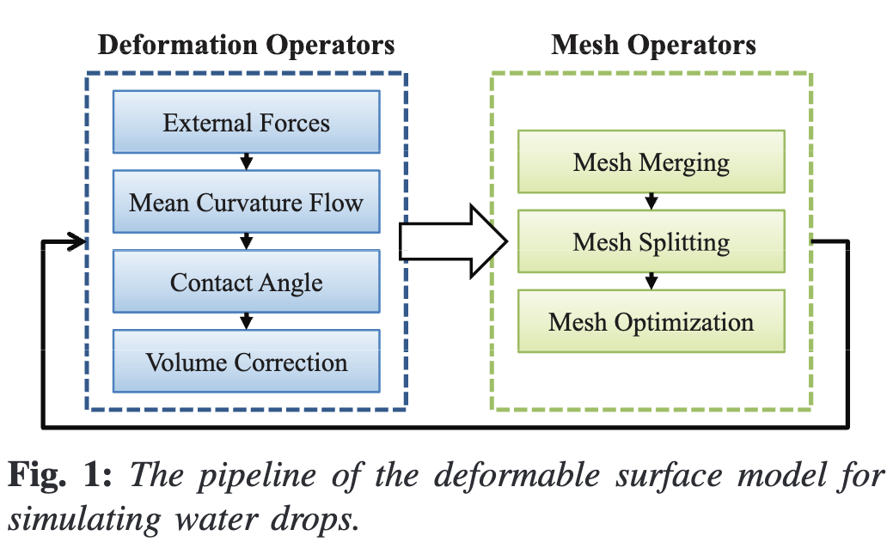
Dynamics (Zhang et al. 2012)
Handle mesh deformation from internal and external forces
Clean up and process mesh artifacts

Slide 3
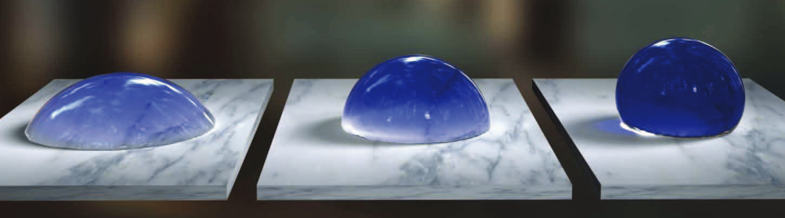
Dynamics (Zhang et al. 2012)
Explicit Euler Method
Clumped
Surface tension behaviours simulated using Mean Curvature Flow (Sussman et al., 2009)
Global + local volume correction
Surface-droplet contact forces
(Hydrophobicity) Droplet contact angle correction
Contact Angles - Zhang et al., 2012

Slide 4
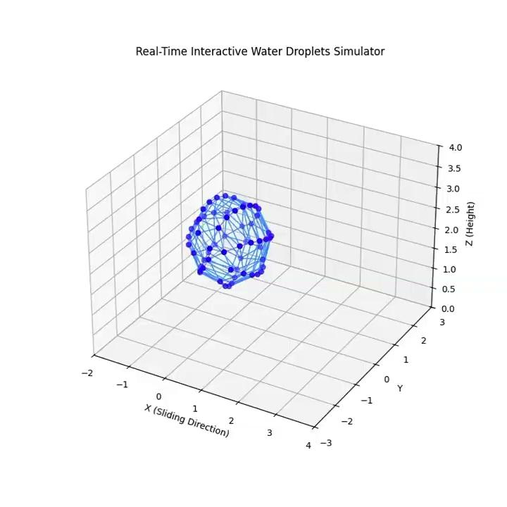
Achievements
Setup functional Python and C++ simulation pipelines
Implemented and verified water droplet dynamics presented by Zhang et al. 2012
Generated correct mesh models
Ported current python approach to C++ implementation.

Slide 5
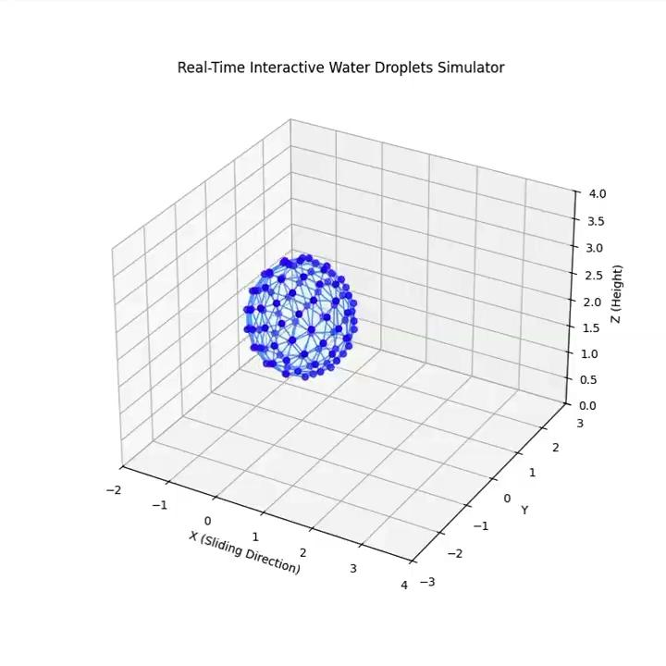
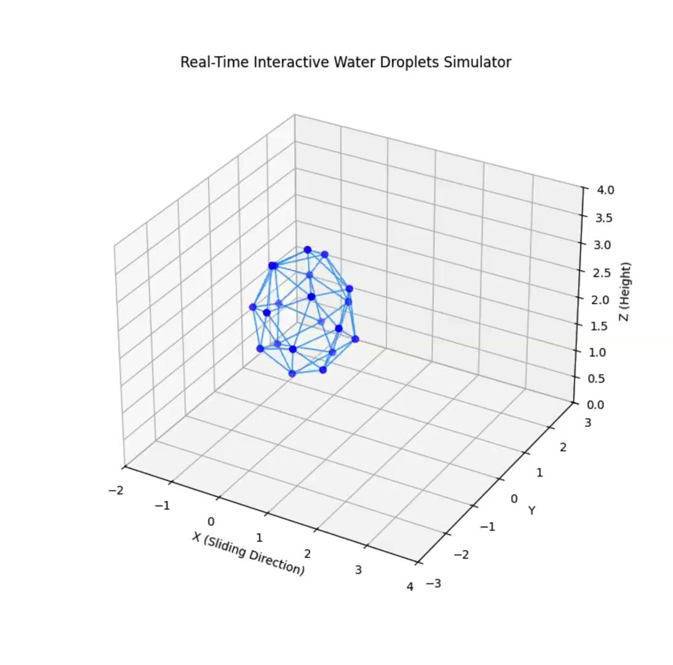
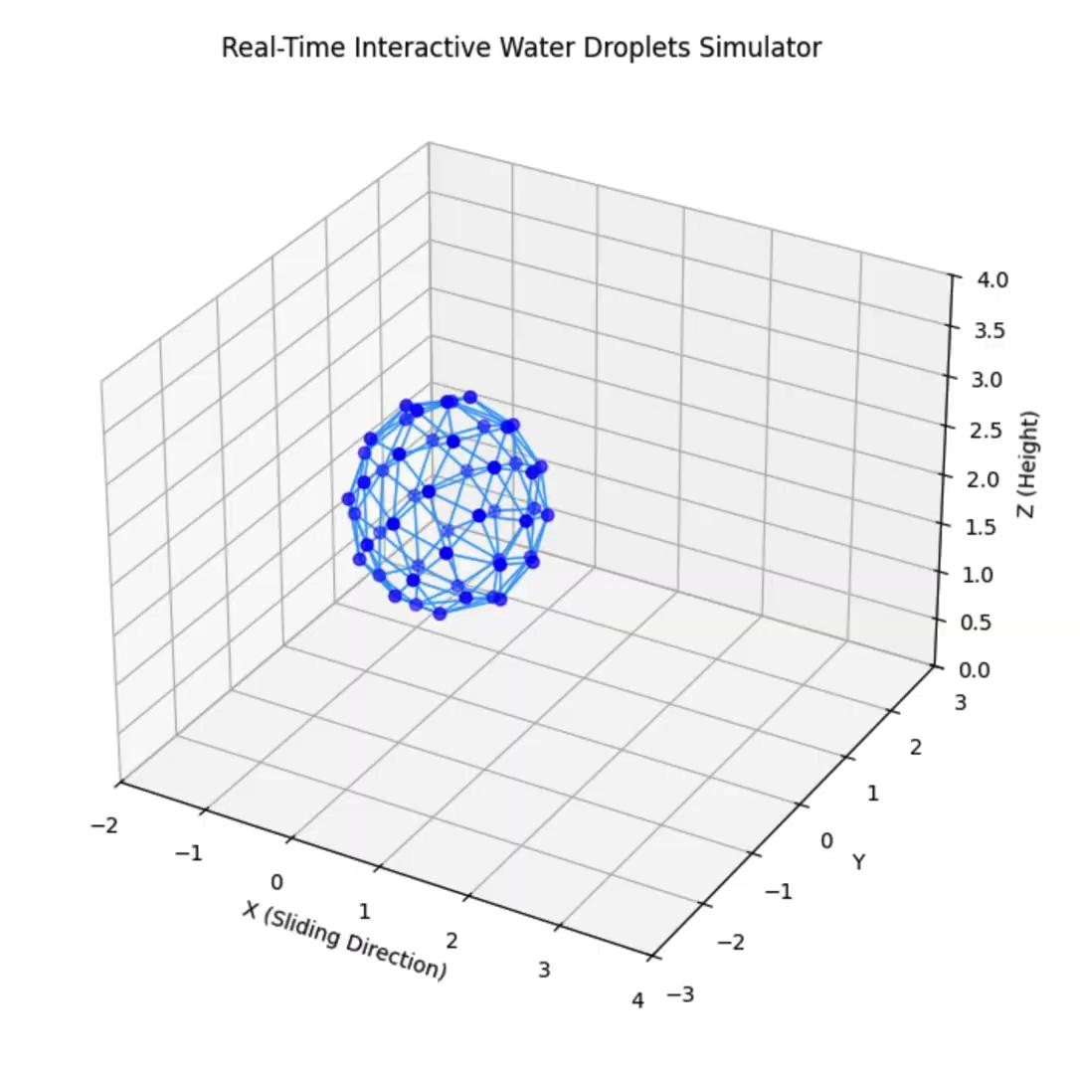
Vertex Density
Droplet ‘spread’ and contact angle depends on density and

Slide 6
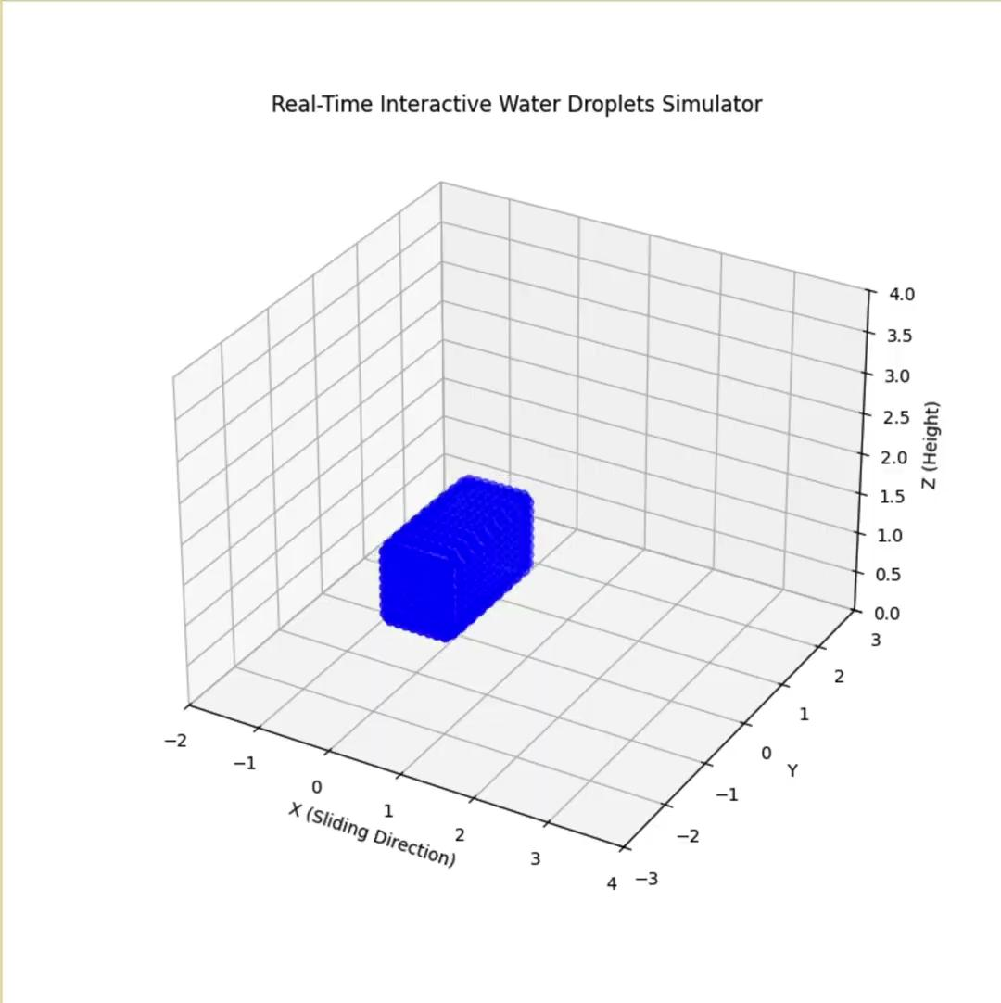
Surface Tension

Slide 7
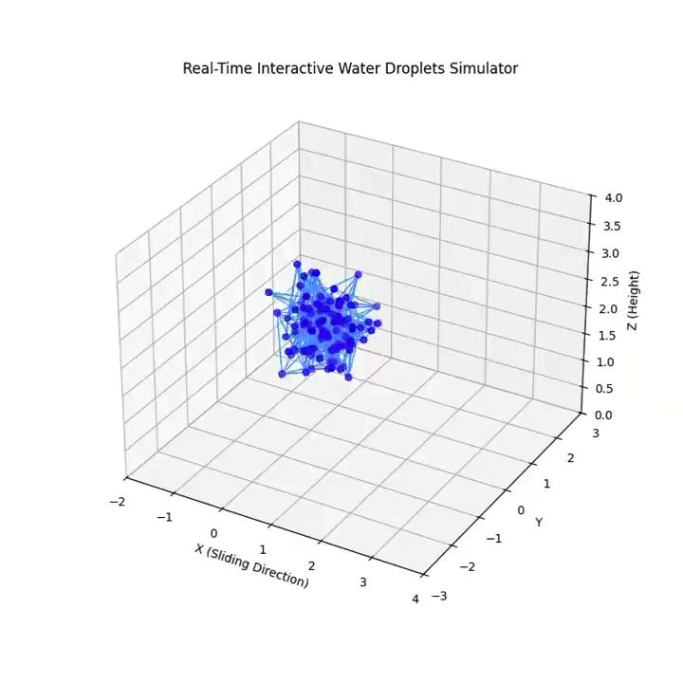
Challenges
Numerical instability at high surface tensions
Difficulties tuning parameters to prevent droplet collapsing
Not real-time

Slide 8
Next Steps (Simulation)
Try Verlet Integration (better for particle simulations) to resolve numerical stability
Investigate computational speed-ups once functional simulation implemented in C++
Tracking performance metrics in CSV files to optimize steps in rendering pipeline
Investigate mesh splitting / merging

